Slide 1

Department of Software Engineering(SWE) Project Course Title: Softwer Requirement Specification & Analysis Course Code: SE-212 Submitted To: Department Head: Dr.Imran Mahmud Dept.of SWE Submitted By:
Md.Abdullah al mamun
Id:201-35-3087
Sec:C

Slide 2
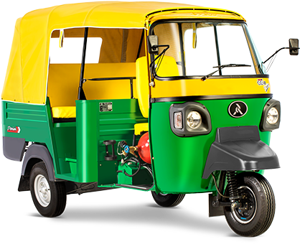
Project Name:mama jaiba/মামা জাইবা By Cng User Passengers

Slide 3
Table Of Content
1.User Profile
2.Function Requirement
3.Use Case Diagram
4.Story Board

Slide 4
User Profile: Mama jaiba/ Passenger
Type of user | primary
Age Range | 18+
Frequency of use | Unlimited
Mandatory/Voluntary | Voluntary
Computer Experience | Not Required
Goals | App To Request a Ride
Language | Basic English
Education | Not Required
Number of users | unlimited
Training | Not Required
Other System used | Not Required
Way of Working | Need Smart Phone,Need Internet phone,Mobile GPS,Phone Sim Card

Slide 5
List of Functional Requirements Functional Requirement: For Passenger
Requirement Id | FR p.1
Requirement Name | Select Language
Description | Passenger can select language
Requirement Id | FR p.2
Requirement Name | Create Account
Description | Passenger can create their user account
Requirement Id | FR p.3
Requirement Name | Location
Description | Passenger can location his/her Location

Slide 6

Use Case Diagram
Log in
Registration
View Driver Profile
Confirm Mama Jaiba
Bid
Driver
Payment
Edit Profile

Slide 7

mama jaiba
Welcome mama jaiba apps
Next

Slide 8

mam jaiba
Enter your mobile number
+880
1827****33
By contnuing you may receive
an sms for verification code
Next

Slide 9
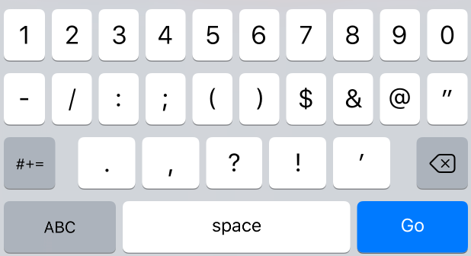
mama jaiba
Enter the 4-digit code send
to you at+8801827****33
1
4
9
6
Resend code in 00.12
Next

Slide 10

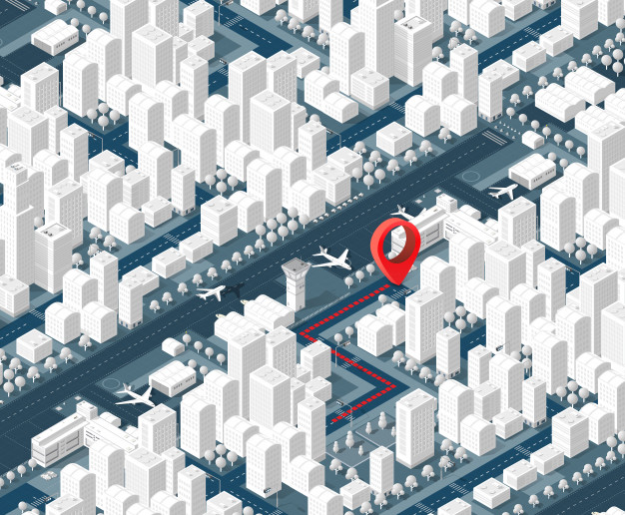



mama jaiba
Where to?
Home
Work

Slide 11

Hse 26/5/GHA, Lane, Moneshwar
k Block ,South Banasree
Home
Add Home
Work
Add Work
Jamuna Future Park
New Market

Slide 12
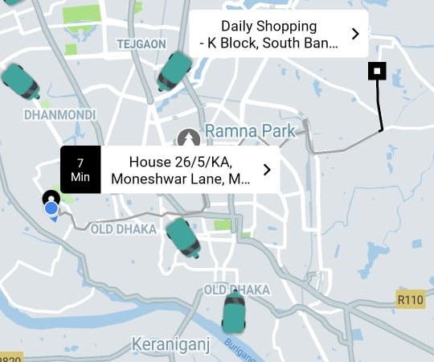


Cng Time Bid
Rech by 4.44pm
200
Rech by 4.44pm
100
confirm mama jaiba

Slide 13


Cng is on the way
2
min
Driver Name
ABC
Age
22
Cng number
00340
Receive Cng

Slide 14
Go to My destinatio
Cancel Trip

Slide 15

Payment type
cash
Mobile Bank
Trip End

Slide 16

Driver Review
Behavior
Dress
Cng Review
Speed
Average
Clean
Good
Review Done

Slide 17
mama jaiba
Thanks use mama jaiba

